Slide 1
SPPS 255: Principles of Pharmacoepidemiology
Monday, 31 March 2025

Slide 2
Proposed plan
Course Schedule (subject to change)
Week 1 – Introduction to Pharmacoepidemiology / Pharmacoepidemiology study designs
Week 2 – Discussion on readings
Week 3 – Administrative databases (e.g., claims, registries, electronic health records)
Week 4 – Discussion on readings
Week 5 – Bias and Confounding / Methods to address bias and confounding (e.g., propensity score matching)
Week 6 – Discussion on readings
Week 7 –Medication Use Evaluation / Drug Use Evaluation/Drug Use Review
Week 8 – Discussion on readings
Week 9 – Pharmacovigilance / FDA and safety
Week 10 – Bioethical issues and Closing Statement

Slide 3
This quarter…
Course Objectives
Describe the basic principles of pharmacoepidemiology
Understand the application of pharmacoepidemiology in the context of healthcare practice
Understand the role of pharmacovigilance in healthcare practice and policy
Critically evaluate the research methods used in pharmacoepidemiology research
Identify and develop strategies to address bias, confounding, and effect modification
Understand the purpose and distinguish between a Drug Use Evaluation, Medication Use Evaluation, and Drug Use Review
Describe the impact of pharmacoepidemiology on practice and policy.
Critically evaluate the pharmacoepidemiology literature

Slide 4


This quarter…
Course Objectives
Describe the basic principles of pharmacoepidemiology
Understand the application of pharmacoepidemiology in the context of healthcare practice
Understand the role of pharmacovigilance in healthcare practice and policy
Critically evaluate the research methods used in pharmacoepidemiology research
Identify and develop strategies to address bias, confounding, and effect modification
Understand the purpose and distinguish between a Drug Use Evaluation, Medication Use Evaluation, and Drug Use Review
Describe the impact of pharmacoepidemiology on practice and policy.
Critically evaluate the pharmacoepidemiology literature
Independent thinker

Slide 5

What this elective is about
We’ll talk about pharmacoepidemiology, but…
Come prepared with one question about pharmacoepidemiology

Slide 6
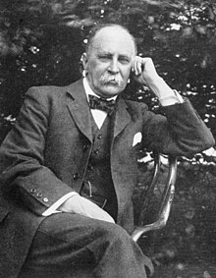
We need evidence
“The practice of medicine is an art, based on science.”
- William Osler

Slide 7
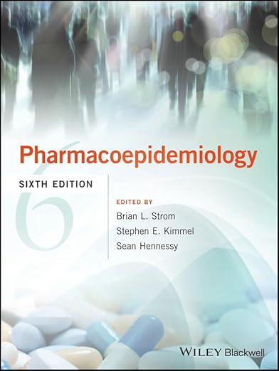
definition
“Pharmacoepidemiology is the study of the use of and the effects of drugs in large number of people.”
- Brian L. Strom

Slide 8
Pharmacology + epidemiology
Clinical Pharmacology
Epidemiology
Studies the effects of drugs on the human body
Studies the determinants, occurrence, and distribution of health and disease in a defined population
Pharmaco-epidemiology
Application of epidemiologic methods on pharmacologic issues
International Society for Pharmacoepidemiology (ISPE). ”About Pharmacoepidemiology.” (link)

Slide 9
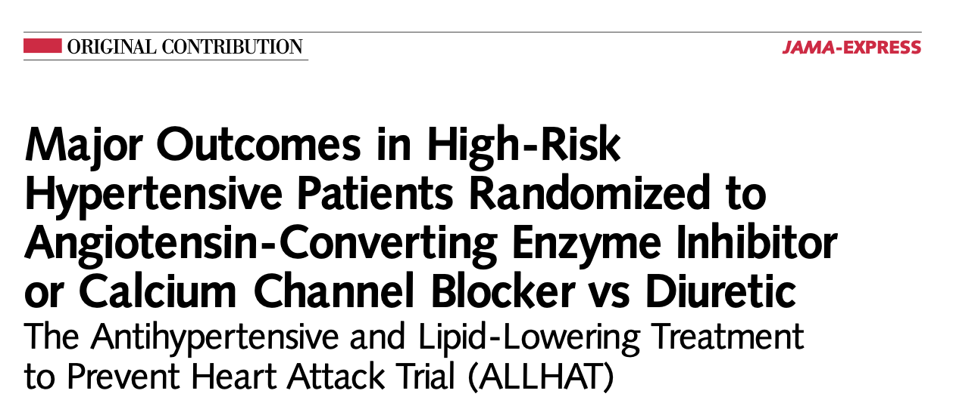
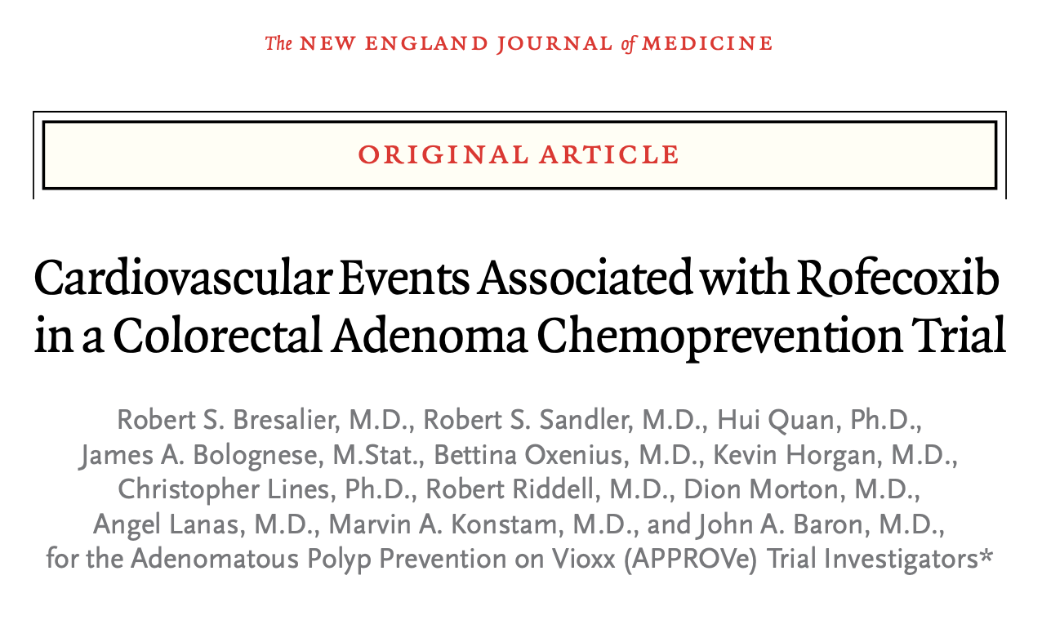
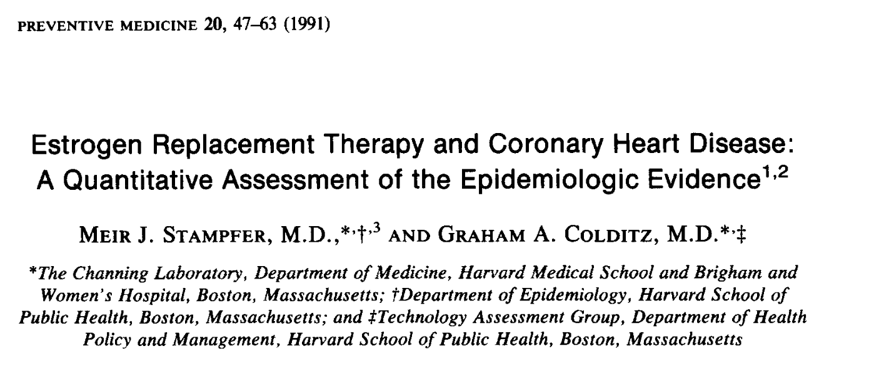
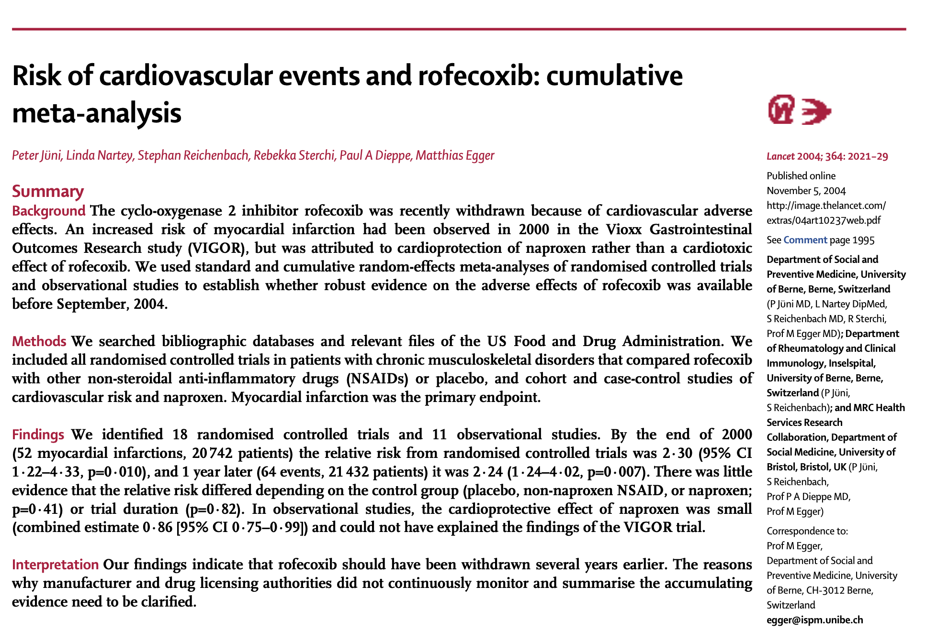
Examples

Slide 10
Pharmacoepidemiology goals
Risk-benefit assessment
Adverse drug effects and Safety
Post-marketing studies
Comparative Effectiveness Research

Slide 11

Pharmacoepidemiology goals
Decision-making

Slide 12



Let’s talk about humans…

Slide 13

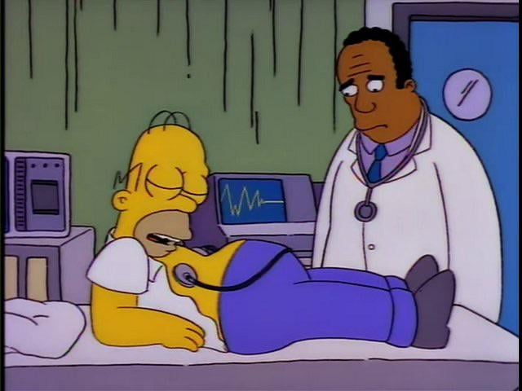
Decisions have consequences

Slide 14
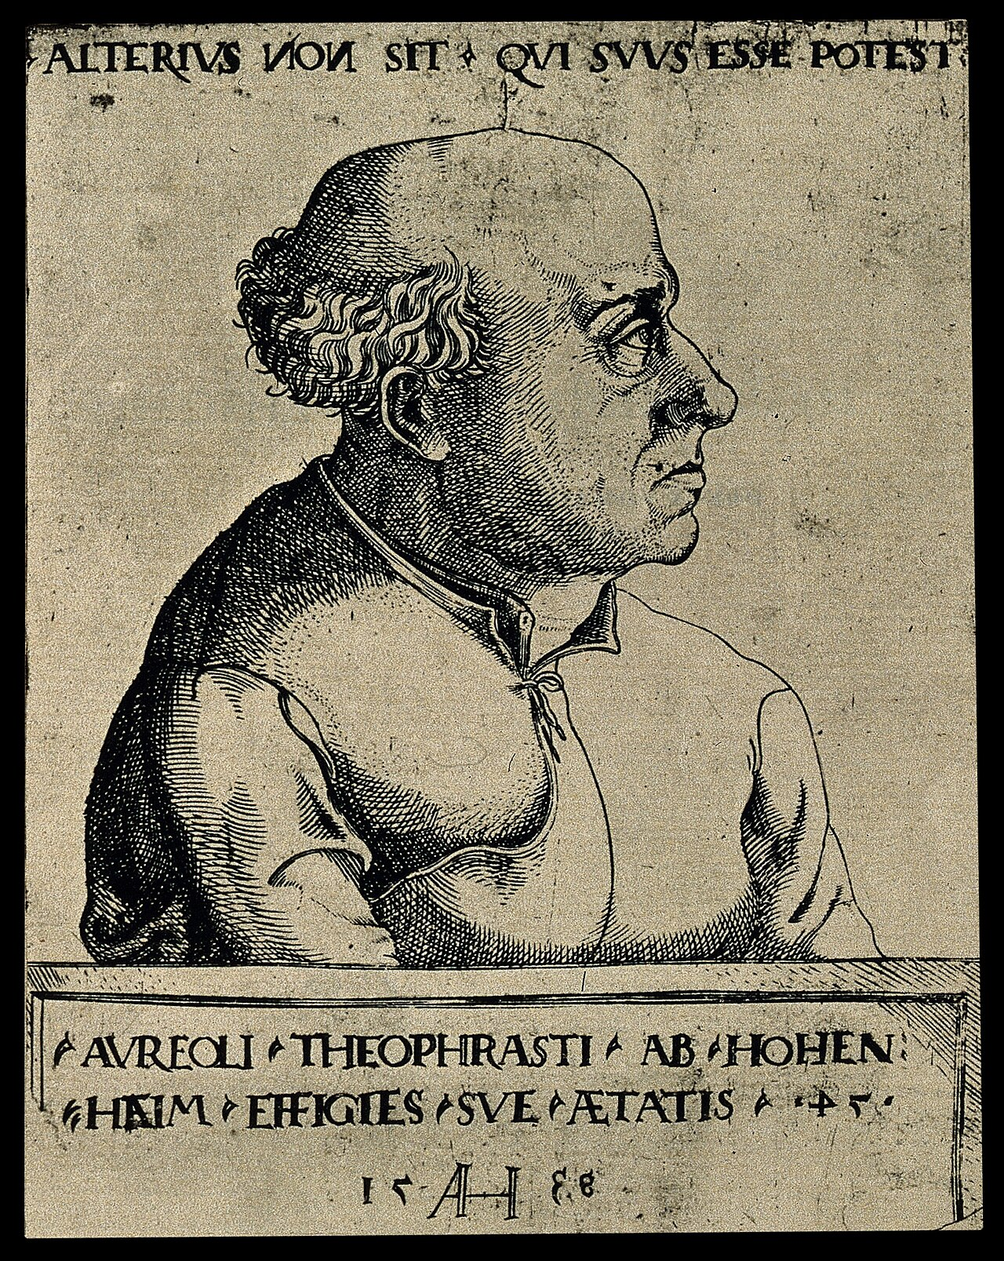
Medications are poisons
“All substances are poisons; there is none which is not a poison. The right dose differentiates a poison from a remedy.”
- Paracelsus

Slide 15
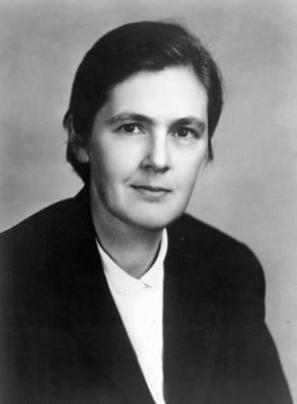
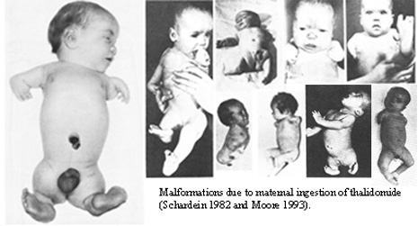
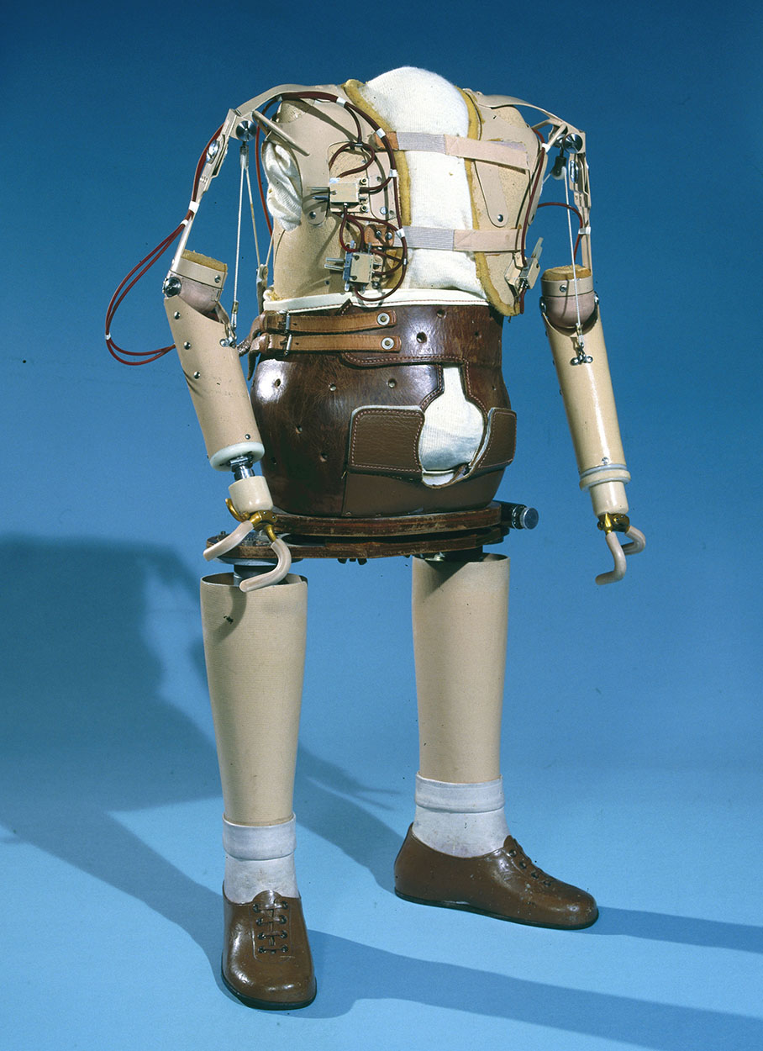
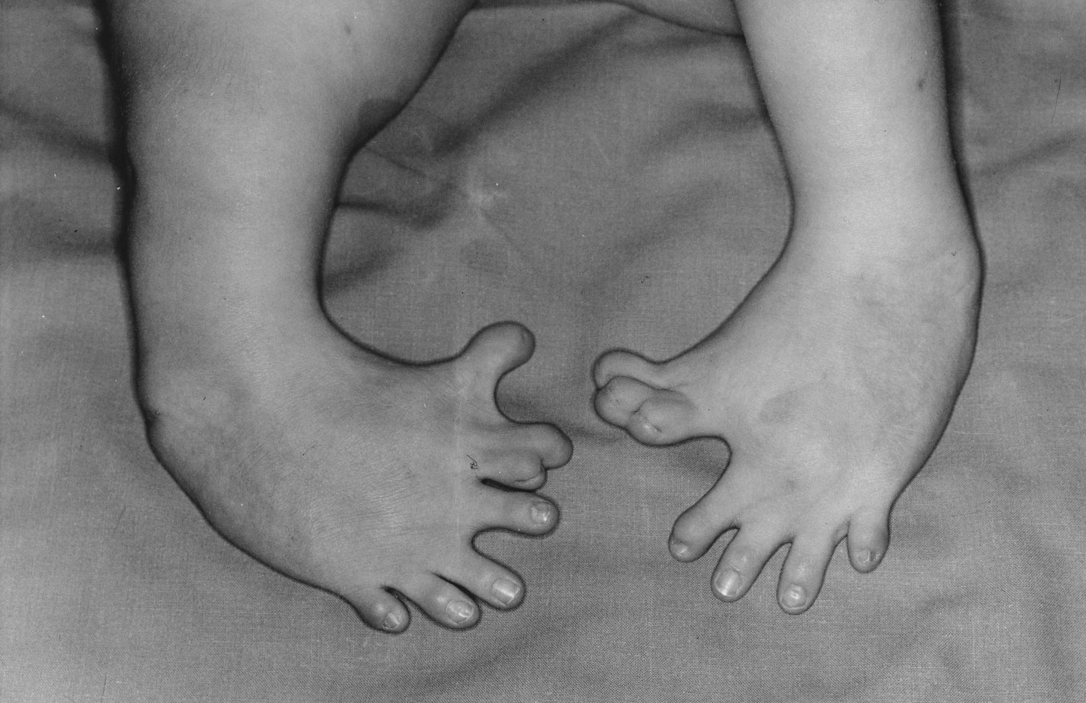
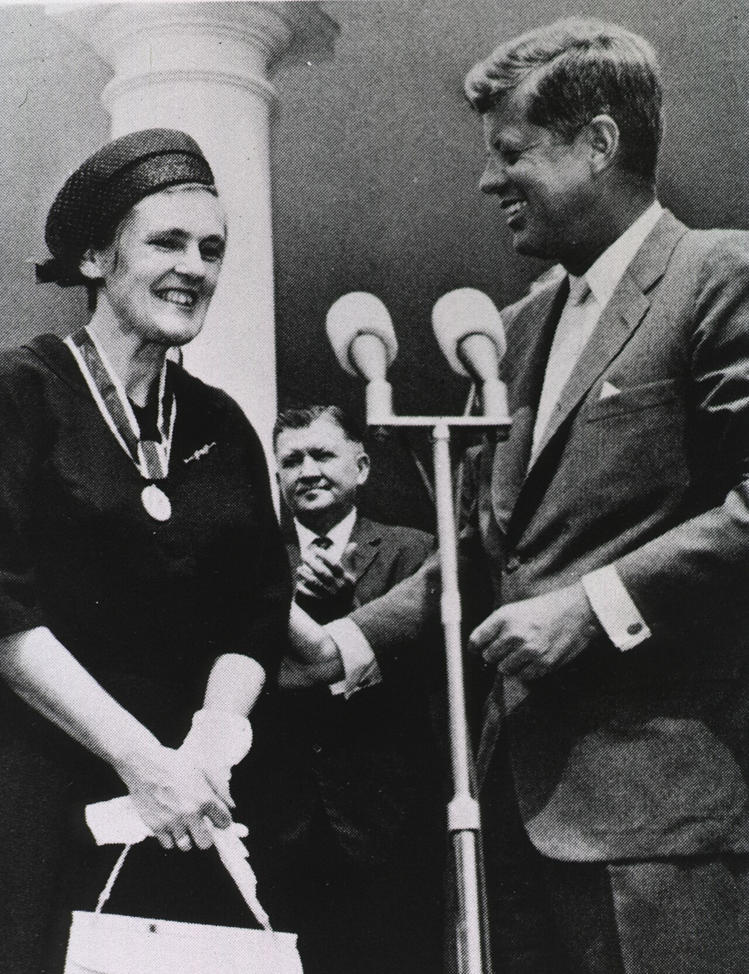
Thalidomide case
“Deficiencies in all areas were found during the initial review of the thalidomide application and in several subsequent resubmissions.” – Kelsey (1988)
Thalidomide was used in the 1950s and 1960s for pregnancy-induced nausea/vomiting in Europe
Pressure to approve its use in US markets, but Dr. Frances Kelsey delayed approval to gather more evidence on its safely profile
>10,000 children developed phocomelia
Changed how toxicology was performed for new drugs entering the market
Kim JH, Scialli AR. Thalidomide: the tragedy of birth defects and the effective treatment of disease [published correction appears in Toxicol Sci. 2012 Feb;125(2):613]. Toxicol Sci. 2011;122(1):1-6. doi:10.1093/toxsci/kfr088
Vargesson N, Stephens T. Thalidomide: history, withdrawal, renaissance, and safety concerns. Expert Opin Drug Saf. 2021;20(12):1455-1457. doi:10.1080/14740338.2021.1991307
Kelsey FO. Thalidomide update: regulatory aspects. Teratology. 1988;38(3):221-226. doi:10.1002/tera.1420380305

Slide 16
Costs associated with drug adverse events
Between 2014 and 2018, a total of 5113 outpatient onset adverse drug reactions (ADRs) were report to the VA Adverse Drug Event Reporting System (VADERS)^{[1]}
Of which 2792 (~55%) ADRs resulted in hospitalization
Enoxaparin-hemorrhage (drug-ADR) pairing was associated with $29,535
Hydrochlorothiazide/lisinopril-angioedema pairing was associated with $6951
1. Aspinall SL, Vu M, Moore V, Jiang R, Au A, Bounthavong M, Glassman PA. Estimated Costs of Severe Adverse Drug Reactions Resulting in Hospitalization in the Veterans Health Administration. JAMA Netw Open. 2022 Feb 1;5(2):e2147909. doi: 10.1001/jamanetworkopen.2021.47909. PMID: 35142836; PMCID: PMC8832171.

Slide 17
Drug-related morbidity and mortality
Sub-optimal therapy (e.g., non-adherence) is associated with negative externalities
Estimated annual cost of sub-optimal therapies was $528.4 billion (2016US$)^{[1]}
Approximately 16% of total US health-related expenditures in 2016
Individuals who experience treatment failure were associated with $2481; new medical problem, $2610; and both, $2572, annually
1. Watanabe JH, McInnis T, Hirsch JD. Cost of Prescription Drug-Related Morbidity and Mortality. Ann Pharmacother. 2018;52(9):829-837. doi:10.1177/1060028018765159

Slide 18
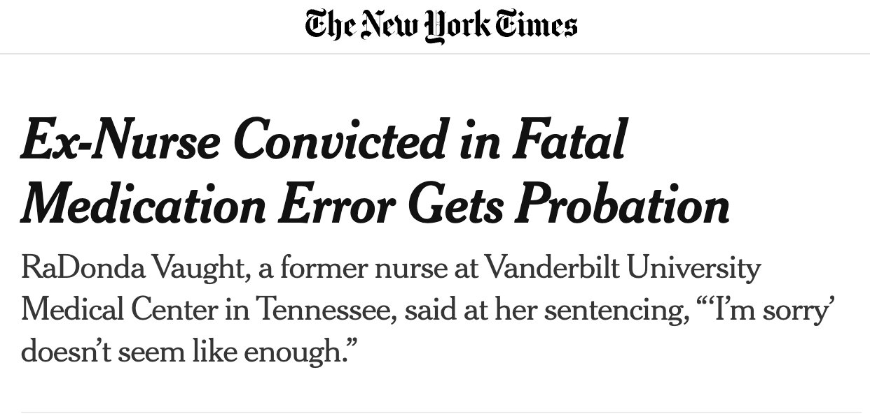
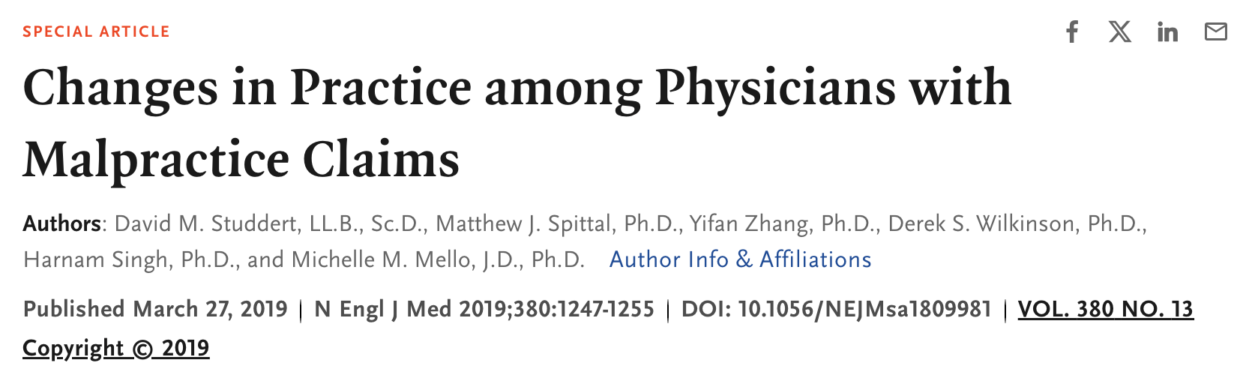
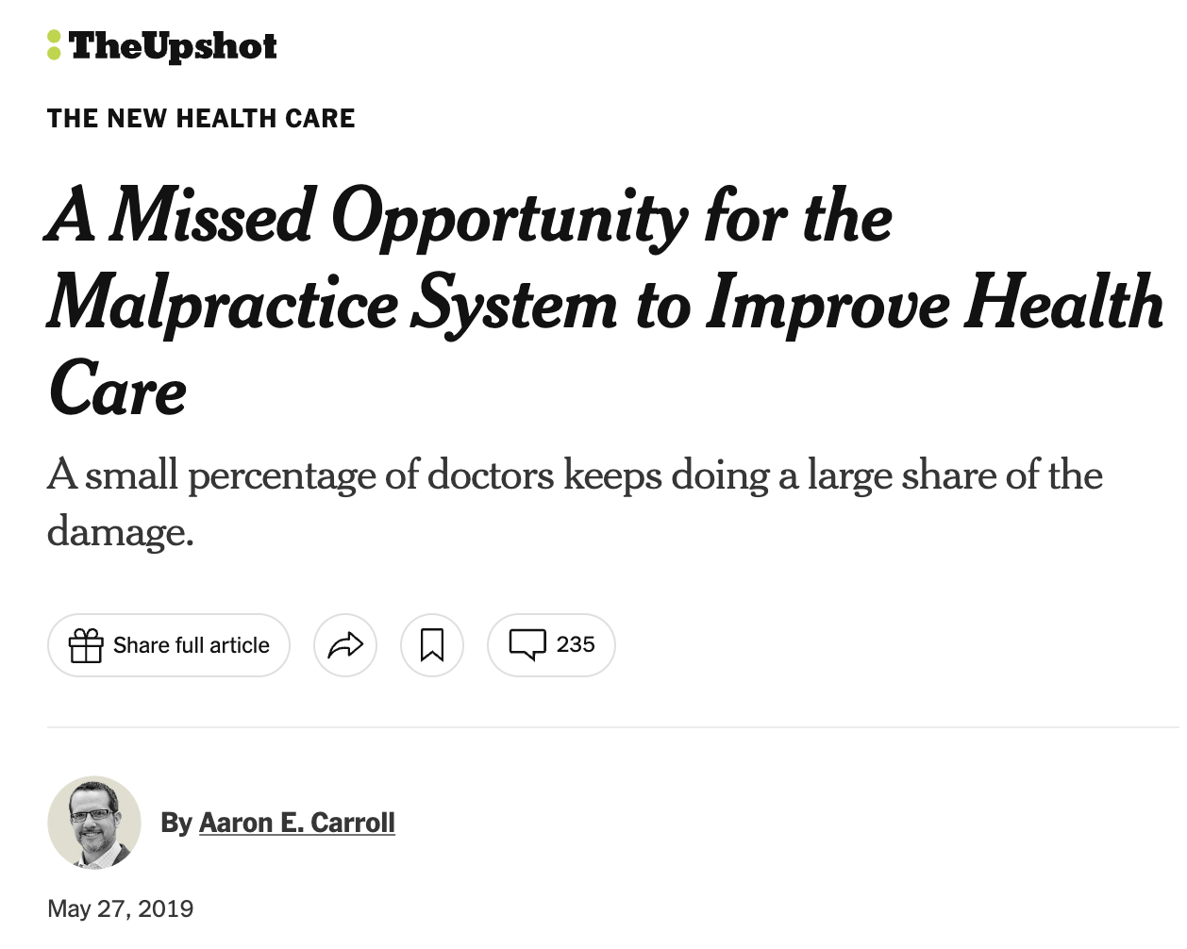
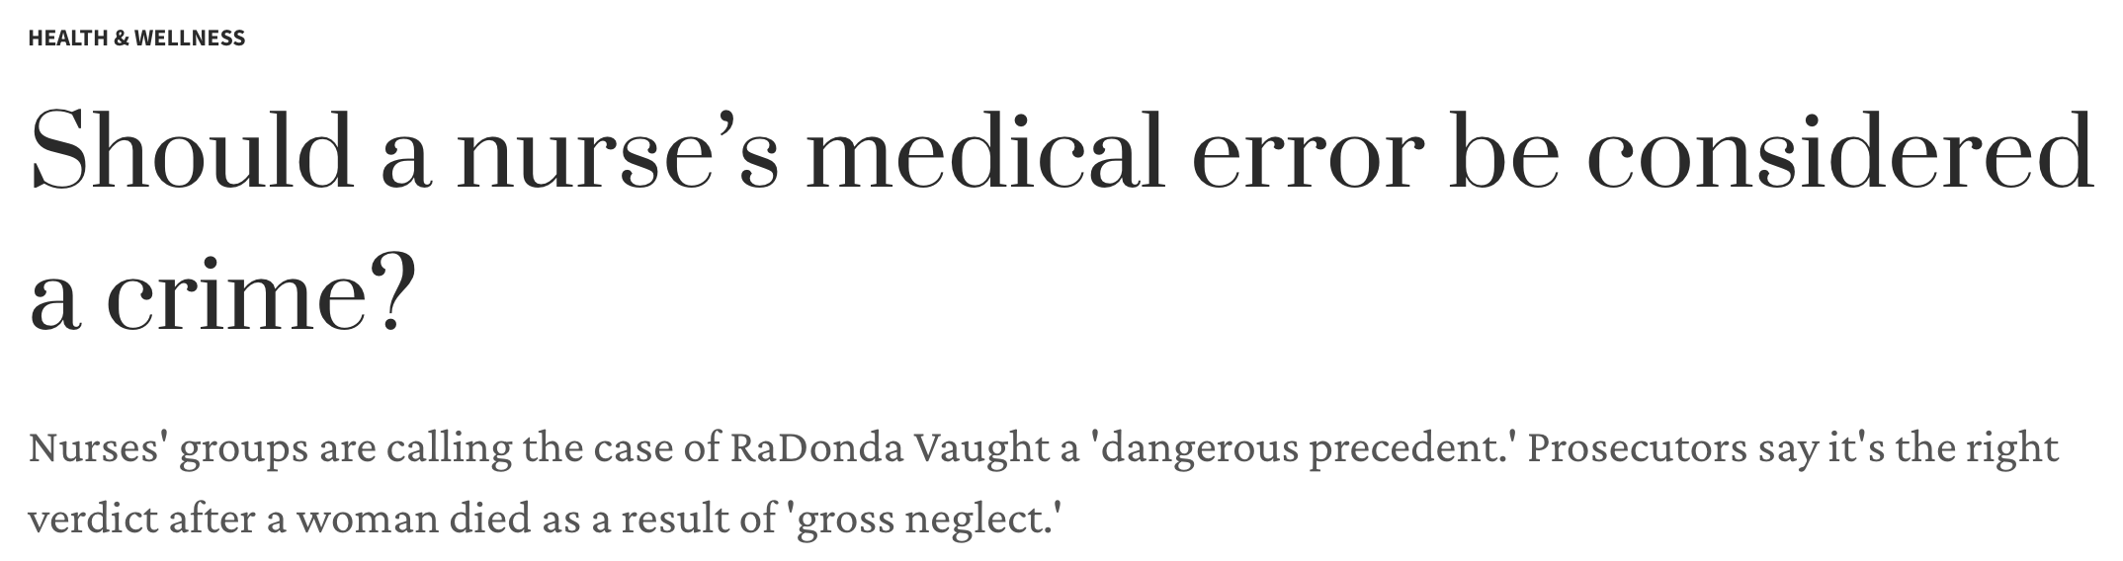
medication errors (related to pharmacoepidemiology)
“To err is human: building a safe health system”^{[1]}
Focus is on the system, not the person
Approximately, 2% of doctors accounted for about 39 percent of all claims in the US.^{[4]}
Institute of Medicine (US) Committee on Quality of Health Care in America, Kohn LT, Corrigan JM, Donaldson MS, eds. To Err is Human: Building a Safer Health System. Washington (DC): National Academies Press (US); 2000.
Medina E. “Ex-Nurse Convicted in Fatal Medication Error Gets Probation.” New York Times. 15 May 2022. (link)
Palowski A. ”Should a nurse’s medical error be considered a crime? TODAY. 13 May 2022. (link)
Carroll. “A Missed Opportunity for the Malpractice System to Improve Health Care. New York Time. 27 May 2019. (link)

Slide 19
Phase I, II, III, and IV trials
Phase I
Phase II
Phase III
Phase IV
70% progress
33% progress
25-30% progress
Dose finding study; side effect and safety objectives;
N = 20 to 100 healthy subjects
Purpose is to evaluate the efficacy and side effect profile among patients with the disease or condition;
N = 100 to 500 subjects with the condition
Larger study to evaluate efficacy and safety;
N =1000s of subjects with the condition
Post-marketing study; Safety and efficacy;
N = 1000s of subjects with the condition
Several months
Months to 2 years
1 to 4 years
Long-term
Placebo control arm is typical
FDA description of clinical trials

Slide 20
common study designs
Features | RCT | Cohort | Case-control | Cross-sectional
Study population | Highly selected population; highly controlled environment | Diverse population observed in a range of settings | Diverse population observed in a range of settings | Diverse population observed in a range of settings
Directionality | Exposure is assigned before outcome is ascertained | Exposure is assigned before outcome is ascertained | Outcome is ascertained before exposure | Exposure and outcome are ascertained simultaneously
Primary use | Causal interpretation; efficacy | Rare exposure | Rare outcome | Hypothesis generation
Analysis | Simple statistical tests | Multivariable methods to account for confounding | Multivariable methods to account for confounding | Multivariable methods to account for confounding
Internal validity | +++ | + | + | +
External validity | ++ | +++ | +++ | +++
Source

Slide 21
Causal inference
Statistical association is a state where researchers can infer relationships between variables through statistical testing (e.g., treatment A is associated with an increase in side effects)
Causal inference is the state where researchers can infer relationships between variables under conditions that are changing (e.g., changes that are induced by a treatment or intervention); it cannot be inferred from statistical associations alone, but from premises that invoke concepts of causation

Slide 22
Causal inference (Hill’s criteria for causation)
Criteria | Description
Strength | Strong associations > Weak associations
Consistency | Repeated observations of associations in different populations and scenarios
Specificity | Cause leads to a single effect (not multiple effects)¹
Temporality | Cause must precede the effect in time²
Biologic gradient | Dose-response relationship
Plausibility | Biological plausibility or mechanism that is logical (or theoretical)
Coherence | Does not contradict with what we know about the nature and history of the disease
Experiment | Hypothesis testing
Analogy | Similar observations in other scenarios
Hill (1965)
This is not considered valid (Hill also had reservations).
This is a necessary component of causation

Slide 23
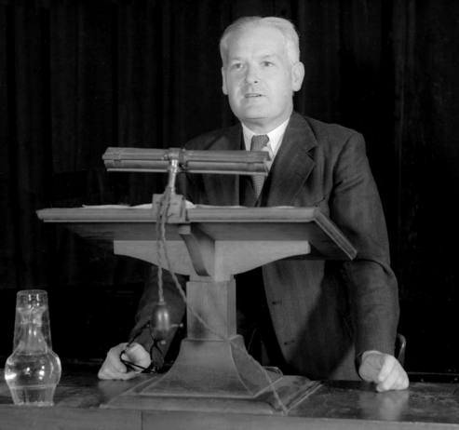
Is this the best model for causation?
“None of my nine viewpoints can bring indisputable evidence for or against the cause and effect hypothesis and none can be required as a sine qua non. What they can do, with greater or less strength, is to help us to make up our minds on the fundamental question—is there any other way of explaining the set of facts before us, is there any other answer equally, or more, likely than cause and effect?”
- Austin Bradford Hill
Hill (1965)

Slide 24
Comparative effectiveness research
“A rigorous evaluation of the impact of different options that are available for treating a given medical condition for a particular set of patients. Such a study may compare similar treatments, such as competing drugs, or it may analyze very different approaches, such as surgery and drug therapy.”
Evidence synthesis
Systematic review
Meta-analysis
Evidence generation
Pragmatic studies
Dissemination
Identify priority topics
Knowledge translation (e.g., guidelines)
Knowledge exchange / utilization (e.g., decision-support system)
Assessment / Implementation process

Slide 25
Guidelines for good pharmacoepidemiology practices (gpp)
GPP Goals (link)
To assist researchers in adhering to good pharmacoepidemiologic research principles, including the use of pharmacoepidemiologic studies for risk management activities and CER.
To promote sound pharmacoepidemiologic research by encouraging rigorous data collection, analysis, and reporting.
To provide a framework for conducting and evaluating pharmacoepidemiologic studies.
To facilitate the appropriate utilization of technical resources by promoting careful study design and planning of study conduct.
To facilitate transparency and ethical integrity in research conduct

Slide 26
Back to the definition…
Environment
Safety
“Pharmacoepidemiology is the study of the use of and the effects of drugs in large number of people.”
- Brian L. Strom
New indications
Benefits
Comparative Effectiveness Research

Slide 27
Proposed framework
Biomedical Ethics
Pharmacoepidemiology aims
Pharmacoepidemiology approach
Environment
Safety
Design
Analysis
New indications
Benefits
Data infrastructure
Data collection
Comparative Effectiveness Research
MUE
Pharmaco-vigilance

Slide 28
Let’s return to Osler…
“The practice of medicine is an art, based on science.”
- William Osler

Slide 29
All of us are biased
“Every primitive tribe retains some vile animal habit not yet eliminated in the upward march of the race.”
- William Osler (AKA E Y Davis)
Healey J. "A Vile Custom": The Strange Career of William Osler's "Professional Notes". J Hist Med Allied Sci. Published online November 25, 2023. doi:10.1093/jhmas/jrad072
Persaud N, Butts H, Berger P. William Osler: saint in a "White man's dominion". CMAJ. 2020 Nov 9;192(45):E1414-E1416. doi: 10.1503/cmaj.201567. PMID: 33168766; PMCID: PMC7669299.
Calac A. “Why UCSD Should Drop Medical Legend’s Name.” San Diego Union-Tribune. 25 August 2021. (link)

Slide 30
Lastly,…
“To reach an optimal decision in any given clinical situation, evidence must be applied to an individual patient who has her or his own values, preferences, life ­situations, and goals. Treating not only the disease but also the patient as a whole requires both understanding and application of the best evidence, as well as the skills and behaviors physicians bring to their own practice of the art of medicine.”
- Soko Setoguchi and Ian Chi Kei Wong

Slide 31

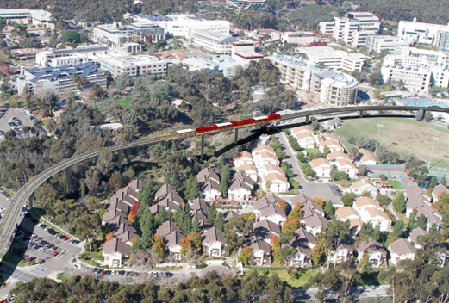
ADDITIONAL RESOURCES
GitHub Site

Slide 32
Place holder
Place holder
All substances are poisons; there is none which is not a poison. The right dose differentiates a poison from a remedy

